Slide 1
Getting started with spark
What it is? How to install and run your first job!

Slide 2
Spark Overview

Slide 3
What is Apache Spark?
Apache Spark was designed to be a fast, general-purpose cluster computing platform.
Spark offers the ability to run computations in memory and is faster than MapReduce for applications running on disk
Spark offers simple API’s in Python, Scala, SQL, and Java

Slide 4
Spark provides an integrated stack
Spark SQL structured data
Spark Streaming real-time
MLib machine learning
GraphX graph processing
Spark Core
Standalone Scheduler
YARN
Mesos

Slide 5
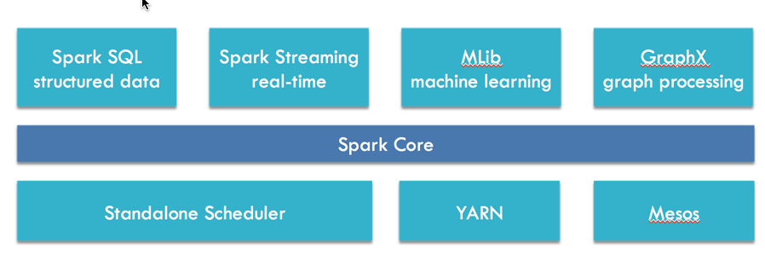
Spark Core
Basic functionality: task scheduling, memory management, fault recovery, interacting with storage systems and more.
Provides the API for resilient distributed datasets (RDDs)

Slide 6
Spark SQL
Point 1
Point 2
Point 3

Slide 7
Spark Streaming
Point 1
Point 2
Point 3

Slide 8
Spark MLib
Point 1
Point 2
Point 3

Slide 9
GraphX
Point 1
Point 2
Point 3

Slide 10
Cluster Managers
Point 1
Point 2
Point 3

Slide 11
Installing Spark

Slide 12
Configuring Spark

Slide 13
Your First Spark Job!

